Slide 1
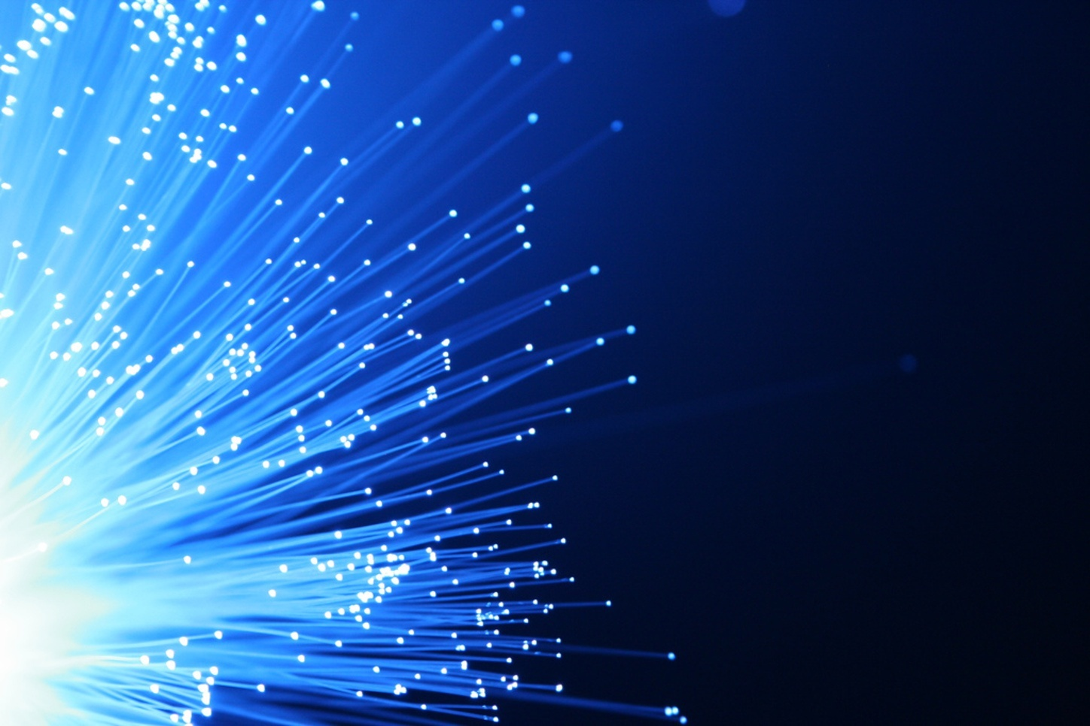

FIBRE OPTICS
https://www.dropbox.com/s/usmmbmz23m8bl85/LASERScpad.pdf?dl=0

Slide 2
Syllabus
Basic principle of optical fibre, step index and graded index fibers
parameters of optical fibers, acceptance angle, acceptance cone, numerical aperture, normalized frequency, No. of modes,
Attenuation in optical fibers, intermodal and intramodal dispersion (no derivation), optical fibers in communication.

Slide 3
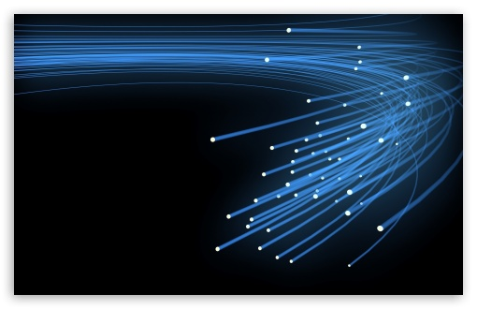

Introduction
An optical fiber is a waveguide for light
An optical fiber is a glass or plastic fiber designed to guide light along its length by confining as much light as possible in a propagating form.
These are arranged in bundles called optical fiber cables and used to transmit light signals over long distances based on the principle of “Total Internal Reflection”
Optical fibers are widely used in fiber-optic communication, which permits transmission over longer distances and at higher data rates than other forms of wired and wireless communications.
The light-guiding principle behind optical fibers was first demonstrated
in by Daniel Colladon and Jaques Babinet in the 1840s, with Irish
inventor John Tyndall offering public displays using water-fountains .

Slide 4
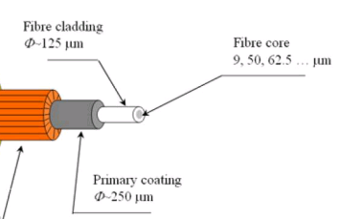
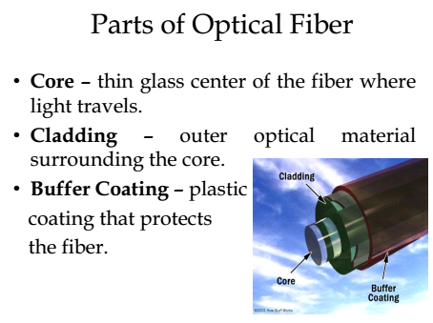
An optical fibre consists of a thin (hair like) long, flexible, cylindrical structure of transparent material at the center called core and has refractive index say μ₁. The core is surrounded by another cylindrical structure of compatible material called cladding and has RI = μ₂, which is slightly less than μ ₁. The whole structure is surrounded by by a protective jacket of thin polyvinyl chloride (PVC) or metal sheath.
Core is made up of thin glass or plastic layer through which light travels.
Cladding is outer optical material of similar type surrounding the core and reflects back the light into the core.
Sheath is plastic coating that protects fiber from any damage or other environmental conditions.
Core Refractive Index
Is slightly greater than that
of Cladding (μ ₁ > μ ₂)
n₂

Slide 5
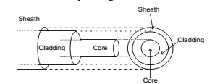
Optical fibers are fabricated from glass or
plastics which are transparent to optical
frequencies. Therefore, based on the nature
of core and cladding the optical fibers are of
three types :
(i) plastic core with plastic cladding (ii) glass core with plastic cladding and
(iii) glass core with glass cladding.
In case of plastics, the core is made up of polystyrene or polymethyl metha acrylate (PMMA) and cladding is made from silicon or teflon.
On the other hand in case of glass, it is made of silica (SiO₂) with RI = 1.458.
The refractive index of pure silica can be increased by doping with germania (GeO₂) or phosphorous pentaoxide (P₂O₅).
Likewise, the refractive index of pure silica can be decreased by doping with Boria (B₂O₃) or Fluorine.
Hence silica can be used in making both the core and cladding.
Cladding in addition to providing a rare medium outside the core required for Total Internal Reflections gives (1) mechanical strength to the optical fibre (2) prevents leakage of signal due to dielectric discontinuities (3) prevents contamination due to environmental attack

Slide 6
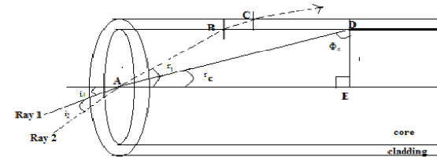
Transmission of Light in Optical Fibre
Consider a step-index optical fibre into which light is launched at the launching end. Consider two rays entering the fibre at two different angles of incidence.
The ray 2 is incident at an angle i₂ w.r.t. the fibre axis. This ray undergoes refraction at point A on the core and is refracted at an angle r₁. The ray reaches the core- cladding interface at point B from where it goes in the cladding and is not propagated through the fibre. The ray 1 incident at an angle i₁ after refraction at A falls at point D on the core-cladding interface at an angle Φ_{c} (critical angle) and propagates along the core-cladding interface. When angle of incidence > Φc the ray undergoes total internal reflection at D, since μ₁ > μ₂. A ray incident with an angle larger than Φc will be confined to the fibre and propagate through the optical fiber via repeated total internal reflections.
.

Slide 7
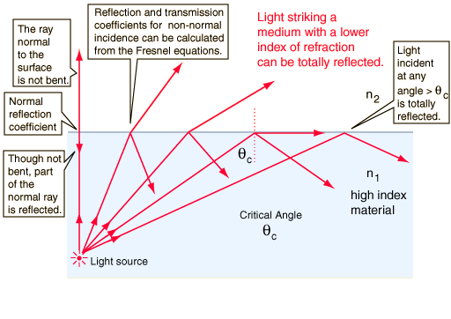

Slide 8
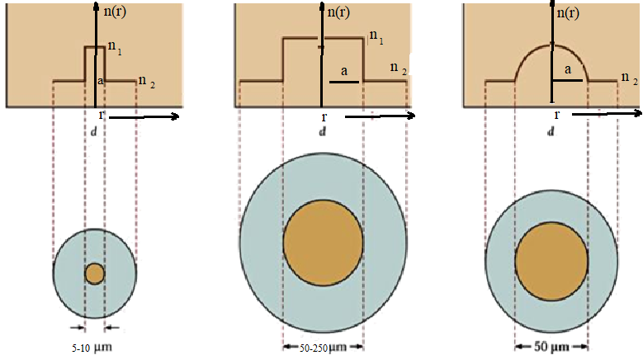
Types of Fiber
Step-index fibers →
The core of Step-index optical fiber has a constant refractive index which decreases suddenly (in a step) at the core cladding interface to a value equal to the cladding refractive index
Graded-index fiber is a compromised multimode fiber, here the index of refraction gradually decreases away from the center of the core
Graded-index fiber has far less dispersion than a multimode step-index fiber
Step Index Single
Single Mode
Multi-Mode
2. Graded Index
Single mode Multi mode Graded index

Slide 9

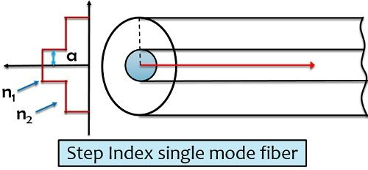
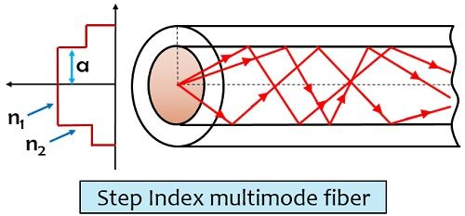
The refractive index profile of step index fibre is defined as
due to the small core diameter , coupling the light inside it is somewhat difficult
best for high speeds,
long distances
large bandwidth can be coupled
Single mode step index optical fiber → extremely narrow core (d≈ 5-10 μm), allows the propagation of only one mode
Higher value of NA , and larger core size makes fibre connections and launching of light easy.
Due to several modes, the effect of dispersion gets increased, i.e. the modes arrive at the fibre end at slightly different times. So a dispersion delay is caused.
quite easy manufacturing, Inexpensive.
In step-index multimode fiber, the core diameter is sufficiently large (50-250 μm) that allows the propagation of multiple modes.
Large core size makes efficient power coupling to the fiber
High attenuation (4-6 dB / km), Low bandwidth (50 MHz-km)
Used in short, low-speed data links
Useful in high-radiation environments, because it can be made with pure silica core

Slide 10
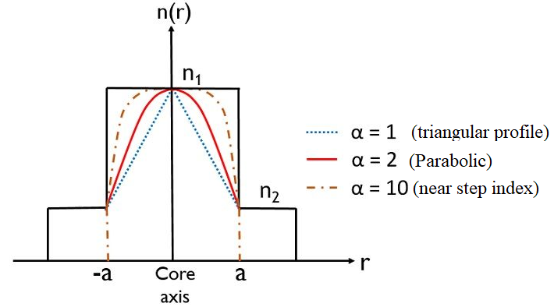

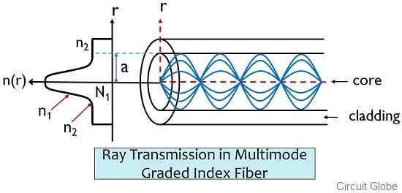
The refractive index of profile of graded index fiber
Is expressed as:
A→ core radius
R→ radial distance from the core axis
Α→characteristic of the refractive index profile (profile parameter)
The light rays moving close to the fiber axis travel in high refractive index region. So these propagate slower than those propagating through the region away from the axis. This is a lower refractive index region, so the rays in this region although travel a longer path but propagates fastly. Hence all the rays reach at the same time at the out put end which reduces the dispersion delay largely.
Can transmit a large amount of information, less distortion in comparison to step index fiber. low light coupling efficiency, expensive

Slide 11
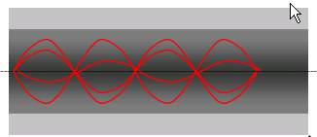
Features of Graded Index optical Fibre
The light waves follow sinusoidal paths along the fiber core.
In this fiber, the refractive index of the core decreases with increasing radial distance (r) from the fiber axis.
The value of the refractive index is highest at the centre of the core and decreases to a value at the edge of the core that equals the refractive index of the cladding.
Useful for “premises networks” like LANs, security systems, etc.
62.5/125 μ is most widely used
Works well with LEDs, but cannot be used for Gigabit Ethernet
Low modal Dispersion
Longer path is now located in lower index region; the larger time taken is compensated by faster travel leading to less pulse broadening

Slide 12
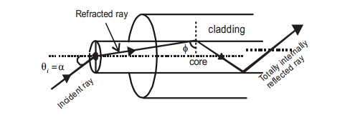
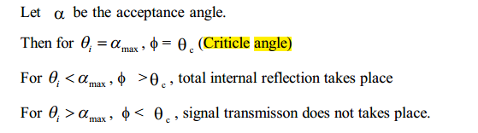
Acceptance Angle
The acceptance angle is the maximum angle made by incident ray of light with the core axis of core at core-outside medium, so that it gets totally internally reflected at core cladding interface and is accepted for propagation. All the rays incident outside this angle are rejected.
The acceptance angle of an optical fiber is defined purely based upon the geometrical consideration (ray optics): it is the maximum angle of a ray (with the fiber axis) hitting the fiber core which accepts the incident light to be guided by the core.

Slide 13
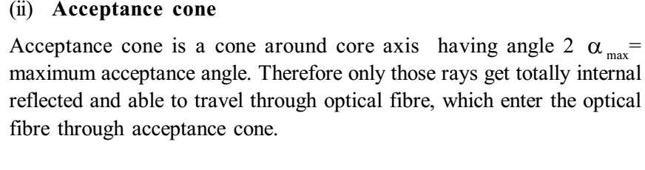
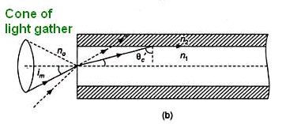
Acceptance Cone

Slide 14
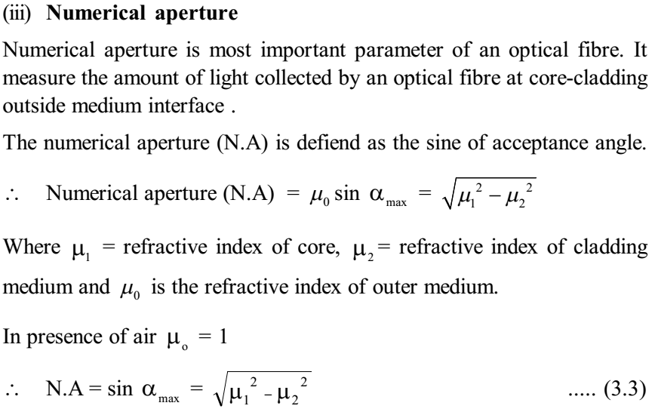

Slide 15
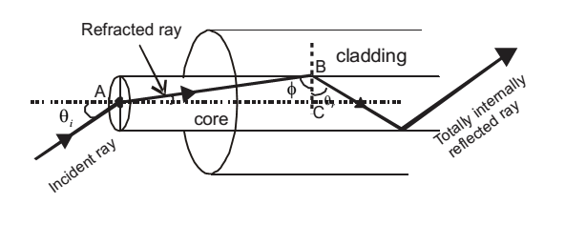



Relationships for NA
For air, n_{o}~1

Slide 16
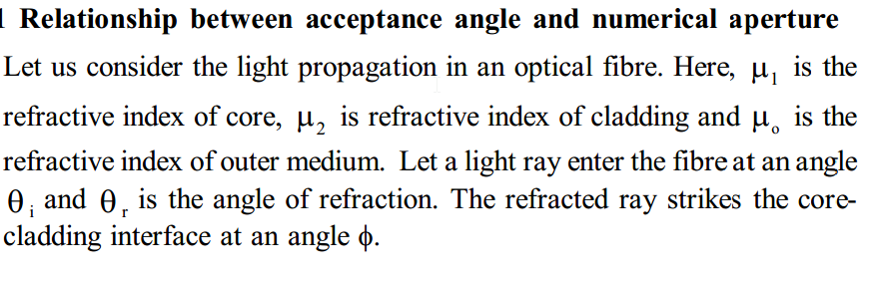
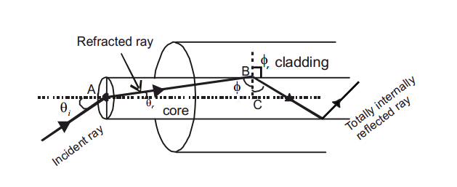
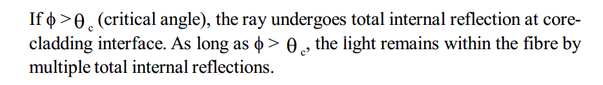

Slide 17
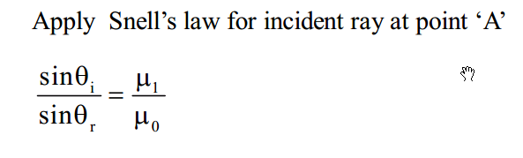
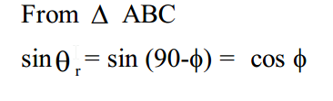
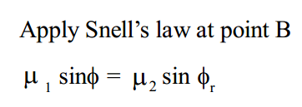
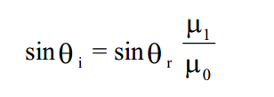
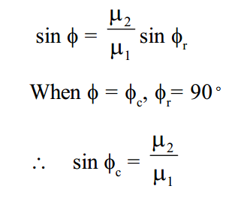
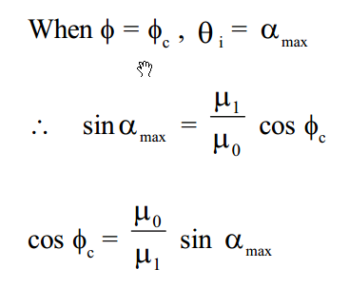
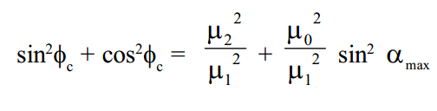

Slide 18
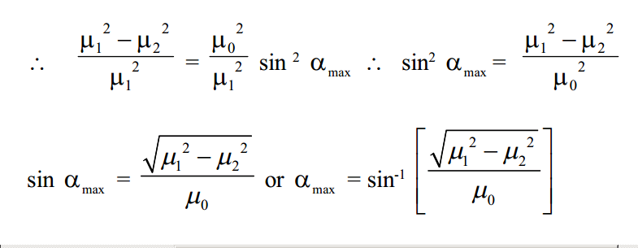
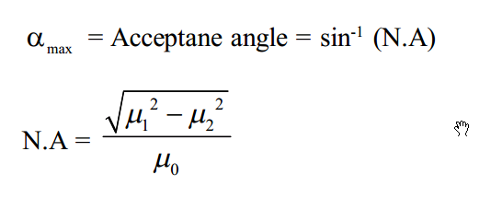

Slide 19
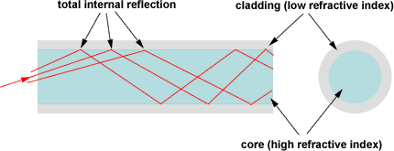
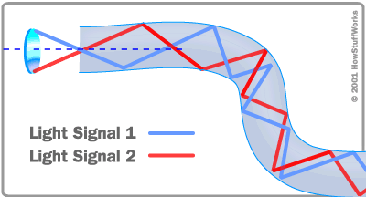
Number of Modes in optical fiber (N)
An optical fiber guides light waves in distinct patterns called modes.
Modes describe the distribution of light energy across the fiber.
The precise patterns depend on the wavelength of light transmitted and on the variation in refractive index that shapes the core.
Modes of an optical fiber are the allowed ray paths in the optical fiber and are given as
N = 2π²a² (NA)²
λ²

Slide 20
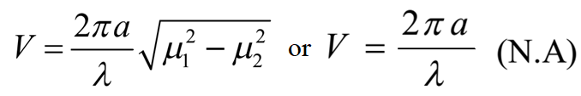



V-number (normalized frequency): It is a measure of the number of guided modes and is given by the following relation
V-number and Number of Modes:
This is only an Approximate formula which is Valid for Large V-Numbers (normalized frequency) only.

Slide 21
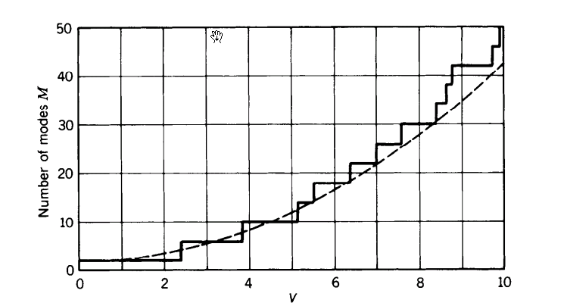

cutoff wavelength
This is the minimum wavelength at which the fiber will support only one mode (single mode operation).
Wavelengths that are shorter than the cutoff wavelength, can actually allow higher-order modes to propagate (multimode operation). When (i) V< 2.405, the optical fiber can support only one mode. (ii) V > 2.405, the optical fiber can support more than one mode and known as multi mode optical fiber. (iii) V = 2.405, the wavelength corresponding to V = 2.405 is known as cut off wavelength (λ_{c}). This separates single mode and multimode operations.

Slide 22
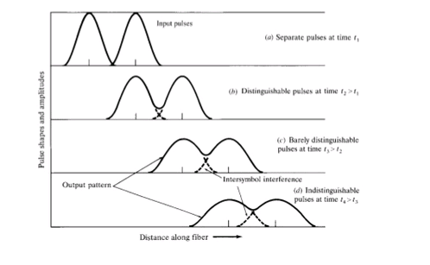
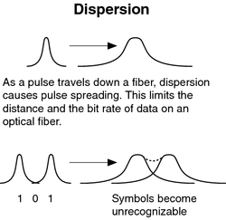
The light signals propagating through the optical fibre suffer with various dispersion effects. As a result the shape of the output signal change relative to the input signal pulse broadening occours.
Signal Distortion or Dispersion In Optical Fibre
The figure on left shows well resolved pulses in the upper part. After propagation through optical fiber the transient time of the pulses increases in comparison to the actual time period of the pulses. This spreading of output pulse in the time domain is known as pulse dispersion or distortion in optical fibre resulting in overlapping of pulses.

Slide 23
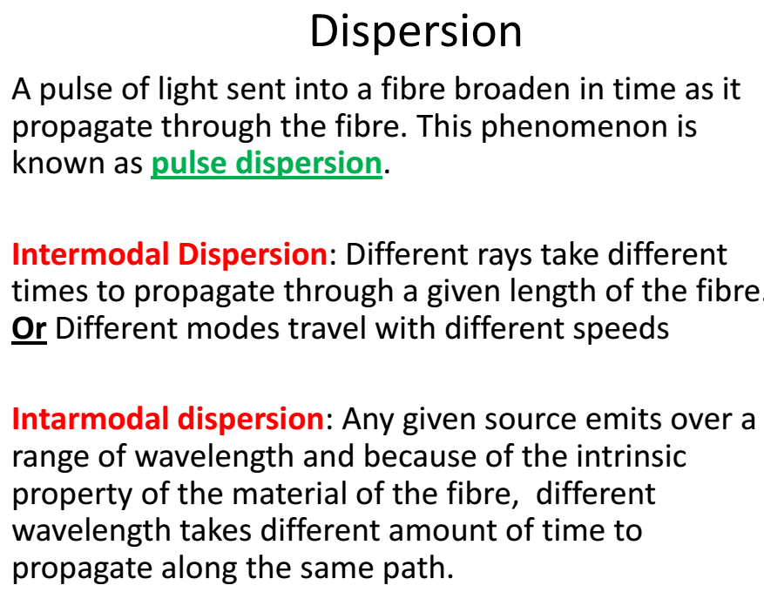
TYPES OF DISPERSION
Pulse Dispersion
Intermodal Dispersion
Intramodal Dispersion

Slide 24
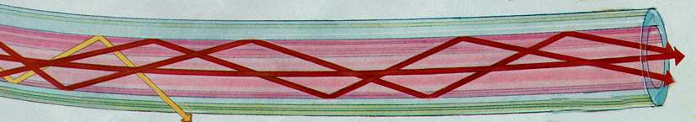
Intermodal Dispersion:
Inter-modal Dispersion:- It takes place because optical signal in multimode optical fibres travel through multiple modes having different group velocities at a single frequency. When the different light rays travel in an optical fibre, each light ray is reflected hundreds or thousands of times following different ray paths. The rays reflected at larger angles (Lower order modes) travel faster than those reflected at lower angles (higher order modes) since the later suffer more no. of reflections and have to cover longer paths. Because of this difference, the higher order modes reach the end of the fibre later than the lower order modes. It means some rays of light waves arrive at the output before other rays. As a result, light pulses broaden as they travel down the fibre, causing signal distortion. This type of distortion is called as intermodal dispersion and becomes significant in multimode optical fibers.

Slide 25
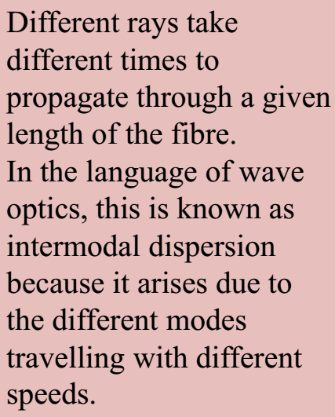
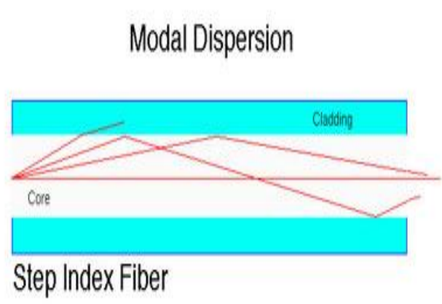
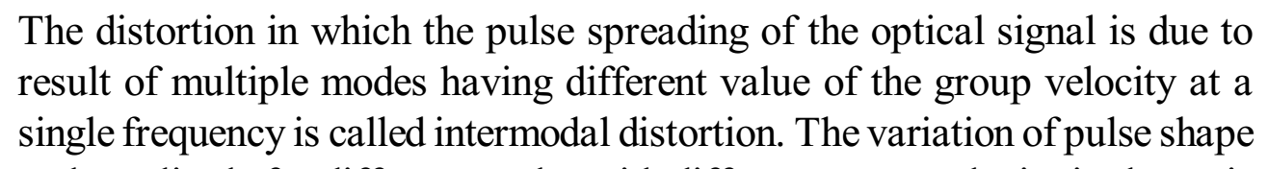
Intermodal Dispersion

Slide 26
2. Intramodal distortion:
The dispersion or distortion in which pulse spreading occurs within a single mode is known as intramodal dispersion. The two main sources of intramodal distortion are
a) Material dispersion. b) Wavelguide dispersion.
a) Material dispersion: It is also known as chromatic dispersion . It occours if the signal consists of a finite band width of wavelengths or frequencies. The material of the core of the optical fibre offers different refractive indices at different angles to the different wavelengths of the optical signal. As a result different spectral components of an optical pulse travel with different propagation speed and exit at different time. Therefore the spectral components of the pulse combine to produce broadened pulse with a lower peak amplitude at the fibre end. This type of dispersion or distortion is analogous to the dispersion phenomena exhibit by light when travel through prism.
The magnitude of intramodal distortion increases with increase in the spectral width of optical signal.
b) Wave guide dispersion: In a single mode optical fibre, 20% signal travels through the cladding and about 80% signal travels through the core by multiple total internal reflections. Since the refractive index of the cladding is less as compared to the refractive index of core, therefore the light signal propagates faster through the cladding as compared to the signal propagation through core. Hence, the shape of output signal is distorted (broadened) due to overlapping of core and cladding signals. Such type of dispersion is known as waveguide dispersion.

Slide 27
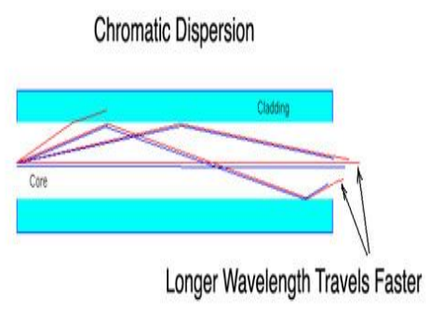
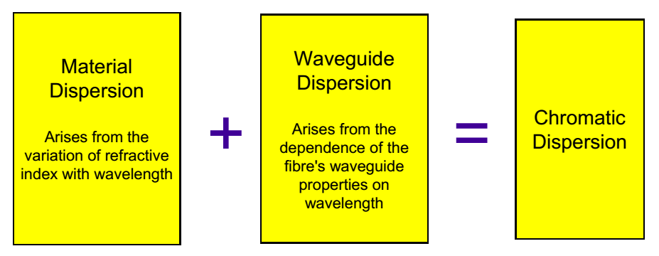
Chromatic Dispersion
Different wavelengths travel at different speeds through the fiber
Chromatic dispersion
occurs in both single mode and multimode fiber
A far smaller effect than modal dispersion

Slide 28
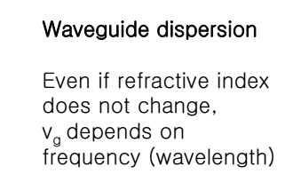
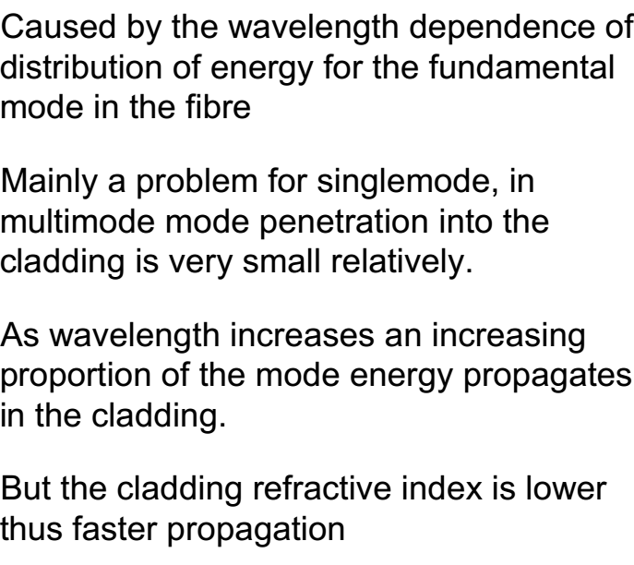
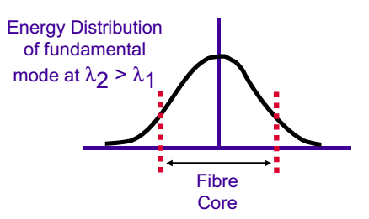
Waveguide dispersion???

Slide 29


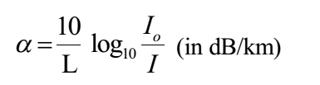
Attenuation (losses) in optical fibers
The loss of light intensity or power in the optical signal is known as attenuation. The main causes of signal attenuation are absorption, scattering (at impurities) and bending of fiber. Therefore, the attenuation of optical signal mainly depends upon the properties of fiber material and fiber structure. Let I_{o} is the intensity of signal fed to the optical fiber and I is intensity obtained at other end of the fiber. Then the attenuation is governed by the following eq.
OR
P_{i} → Input power
P_{o}→ Output power
where α is called attenuation coefficient and L - is the length of optical fiber in kilometers. The attenuation coefficient in terms of length L is given by Unit of attenuation coefficient (α) in decibels/ kilometer (dB/km).

Slide 30
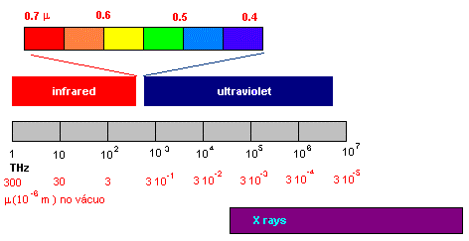
Propagation of L\light
Visible light extends from 380 nm (violet) to 780 nm (red).
For smaller wavelengths ultra-violet radiation (UV) occurs. Longer wavelengths correspond to the infrared region (IR).
Optical Fibre communication elements operate in the micrometer wavelength zone of the frequency spectrum (frequencies between 10¹⁴ Hz to 10¹⁵ Hz).

Slide 31
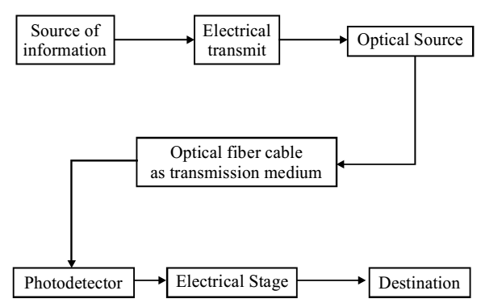
Optical fiber communication system
An optical fiber communication system consists of a transmitter unit, optical fibre and receiver unit as shown in figure. In transmitter unit, the information that is to be transmitted is first converted into an optical signal from an electric signal. Transmitter unit consists of modulator and optical source, which may
be either light emitting diode (LED) or a laser diode (LD). The optical fiber essentially serves the purpose of transmitting light signal by multiple total internal reflections. The receiver unit consists of an optical detector and demodulator. The optical detector may be a semiconductor device, most commonly a PIN diode, which convert the optical signal again into an electric- al signal. The response of a detector should be well matched with the optical frequency of signal received. The signal output is finally communicated by a speaker (if it is audio signal) or by CRO (if it is video signal).

Slide 32

Optical fibre communication system
Advantages of optical fiber communication system:
Greater bandwidth
Less number of repeaters
Less maintenance
Less weight
Lower losses
Much cheaper
Immunity to crosstalk
No electrical hazard
Free from electromagnetic interferences

Slide 33
Light Emitting Diodes used in Optical Fiber Communication
In optical fiber communication systems, LEDs serve as optical sources to convert electrical signals into light pulses.
LEDs are well-suited for shorter-distance multi-mode fiber links due to their wider spectral output compared to lasers. They act as transmitters by injecting light into the fiber core.
Optical fibers are like super highways for data, letting us transmitting huge amount of information quickly. LEDs play a key role in fiber optic communication technology.

Slide 34
Advantages of LEDs in Fiber Optic Communication
LEDs have some great benefits that make them well-suited for use in fiber optic communication systems. Let’s look at why LEDs are the preferred light source for transmitting data over optical fibers.
Compact Size: LEDs are super small in size, allowing them to be easily coupled to the very thin core of optical fibers. Their small light emitting area matches well with the small diameter fiber cores. This maximizes injection of light into the fiber.
Directionality: Unlike the ordinary light bulbs that spread light everywhere, LEDs emit light in a narrow, directional beam. This makes it easy to capture light efficiently into optical fibers.
Cost Effective: LEDs are much-much cheaper as compared to other light sources like lasers. This makes LEDs a cost-effective option for cheap, short-distance fiber links.
Energy Efficient: LEDs convert electrical currents to light very efficiently. This results in lower power consumption compared to lasers or other sources.
Reliable: LEDs are solid-state devices with no fragile filaments or glass. This makes them resistant to vibrations and shocks. LEDs can withstand fluctuating temperatures and harsh conditions. This high reliability is a key advantage.
Easy Modulation: The output light from LEDs can be easily modulated and encoded with data by varying the input electrical signal. This allows rapid flickering for high-speed data transmission.

Slide 35
Photodiodes in Fiber communication
Photodiodes are essential components in optical fiber communication systems, primarily functioning as light detectors that convert optical signals into electrical signals. Their role is crucial for the operation of receivers in fiber-optic communication systems. Here's how photodiodes are used in optical fibers:
1. Signal Detection:
A photodiode is used at the receiving end of the system to convert the optical signals (light) back into electrical signals, which can then be processed further.
2. High-Speed Operation:
Photodiodes are designed to operate at high speeds to handle the rapid transmission of data over optical fibers.
3. Noise and Signal Integrity:
The efficiency of a photodiode directly impacts the signal-to-noise ratio (SNR) in optical systems. An ideal photodiode will minimize noise, maintaining the integrity of the transmitted data.

Slide 36
Injection Laser Diode (ILD)
An Injection Laser Diode (ILD), commonly referred to as a semiconductor laser or laser diode, is a vital component in optical fiber communication systems. Its primary function is to convert electrical signals into coherent light that can be transmitted through optical fibers over long distances.
Laser diodes are preferred in high-speed communication systems due to their efficiency, high output power, and ability to operate at the desired wavelengths required for fiber optic communication.
Role of Injection Laser Diodes in Optical Fibers:
1. Light Source for Data Transmission:
Injection laser diodes are used as light sources at the transmitting end of the optical fiber communication system. They emit a narrow, coherent beam of light, which is modulated with data (digital signals). This light is then coupled into the optical fiber for transmission over long distances.
2. Precise Wavelength Emission:
Injection laser diodes emit light at specific wavelengths that correspond to the low-loss transmission windows of optical fibers. The most common wavelengths used are:
850 nm for multimode fiber systems.
1310 nm and 1550 nm for single-mode fiber systems, which are the most widely used in long-distance communication.
These wavelengths minimize attenuation (loss of signal strength) and dispersion, allowing data to travel long distances with minimal signal degradation.

Slide 37
Difference of Injection laser diode and photodiode in fiber communication
Injection laser diode (ILD)
Photodiode
Transmitter Component: ILDs are used as the light source at the transmitting end of the optical fiber system. They convert electrical signals into light signals that carry data through the optical fiber.
Capable of high-speed modulation, meaning the intensity or phase of the light can be varied rapidly, allowing for the transmission of high-bandwidth data.
Converts electrical signals into optical signals (light).
Acts as the source of light, usually emitting at specific wavelengths like 850 nm, 1310 nm, or 1550 nm.
Receiver Component: Photodiodes are used at the receiving end of the optical system to detect the incoming light signals from the fiber and convert them back into electrical signals. They perform the reverse operation of the ILD.
Converts optical signals back into electrical signals.
Acts as a detector of light at the receiver.
Its primary role is to absorb photons from the light signal and generate electron-hole pairs, producing a current proportional to the light intensity.

Slide 38
Assignment:
What are Optical Fibers? Summarize the principle behind the transmission of light signal through an optical Fiber.
Write the advantages of optical fiber communication system.
Explain the structure/ construction of an optical fiber with the help of an appropriate diagram.
The refractive index of core should be slightly greater than that of cladding. Justify the statement by citing appropriate reasons.
Compare single mode and multimode optical fibers.
Justify the name “step index optical fiber” .
Differentiate between step index and graded index multimode optical fibers.
Derive the expression for (i) critical angle (ii) acceptance angle (iii)numerical aperture.
Define and/ or write expressions for : (i) critical angle (ii) acceptance angle (iii)numerical aperture (iv) fractional refractive index difference (v) V-number (vi) number of modes
Express acceptance angle and numerical aperture in terms of fractional refractive index difference.

Slide 39



Slide 40



Slide 41



Slide 42



Slide 43



